Slide 1

Extreme Learning Process: a Crowd Learning Methodology based on Digital Publishing Workflows
Ben Koo
Tsinghua University
Reimagine Education Awards
December 2014

Slide 2
The Four Basic Rights /Boundaries of Every Learner
Right to use publicly available technologies and other resources in the learning process
Right to resolve conflicts in a dynamic context
Freedom to make decisions related to one’s personal assets
Freedom to express one’s opinions

Slide 3
Learning Objectives
Learn to conduct meetings, and document decisions
Create a workflow based on digital publishing tools
Recombine individual talents to dynamic team structures
Present results using Internet-Scaled media channels

Slide 4
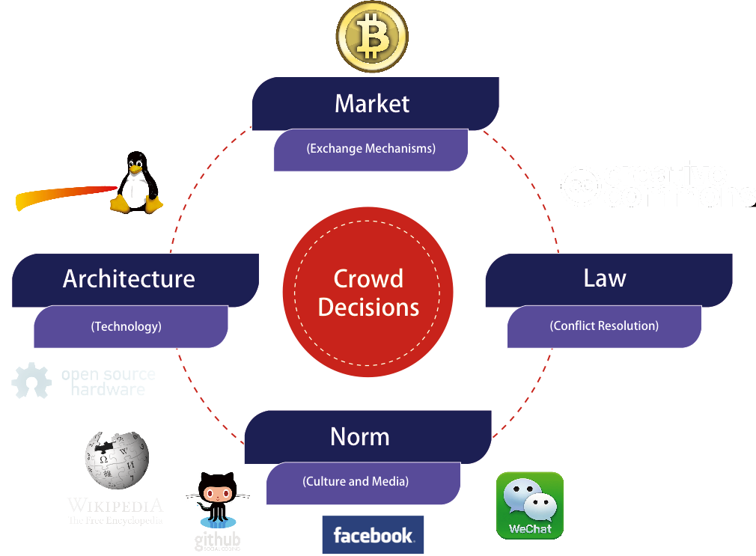


XLP Empowers Learners

Slide 5
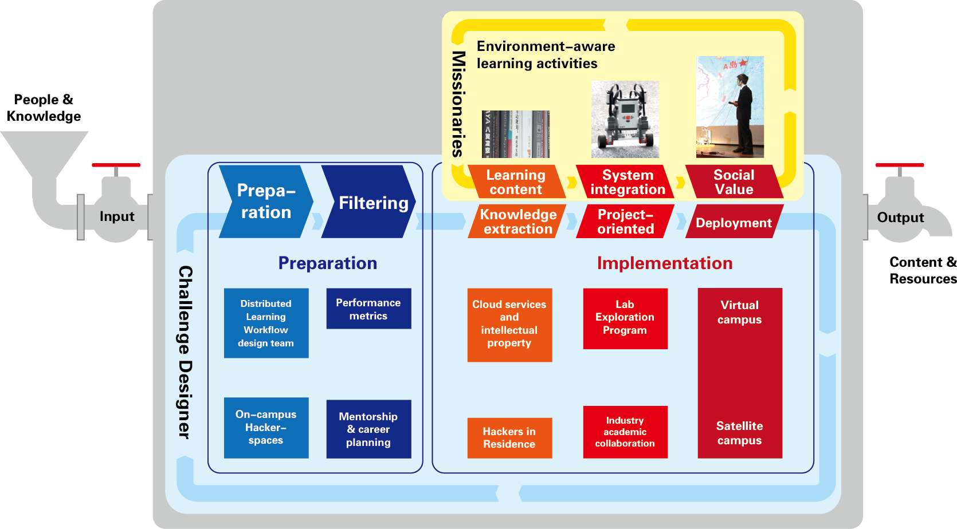
An Iterative Process
Mission Executors
Resource Inputs
Learning Outcomes
Challenge Designers

Slide 6
Follow the Logic Model
INPUTS
OUTPUTS
OUTCOMES
Program investments
Long-term
Activities
Participation
Short
Medium
What we invest
What we do
Who we reach
What results
Source:
http://www.uwex.edu/ces/pdande/evaluation/evallogicmodel.html

Slide 7
Measurable Outcomes
OUTCOMES
Long-term
Short
Medium
Total Number and Frequency of people using the product
“Constitution for Learning Organizations”

Slide 8
Digital Publishing
Networked Collaboration as a Publishing Process
Product Development
Distributed Content Management
Demo Product
Planning and Management
Web Platforms
Modeling Tools
(Programming Languages, AutoCAD, PhotoShop, InDesign)
Media Events
Idea Generation and Goal Definition
Content Distribution Protocol (Git)
Data Collection
Devices (Cameras, Microphones,
Input Devices)
Prototyping Tools
(Lego, Makeblock)
Story Boarding
(PowerPoint)
Computation Resources
Time Tables
(SmartSheet)
Testing Instruments
635 Method
Integration Tools
(Gitbook)
Mission Statement
Multi-Level Design Contracts (XMind)

Slide 9





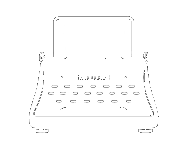





Write
Design Layout
Review
Publish
Digital Publishing
Code
Design GUI
Test
Release
Design
CAD Model
Prototype
Build

Slide 10
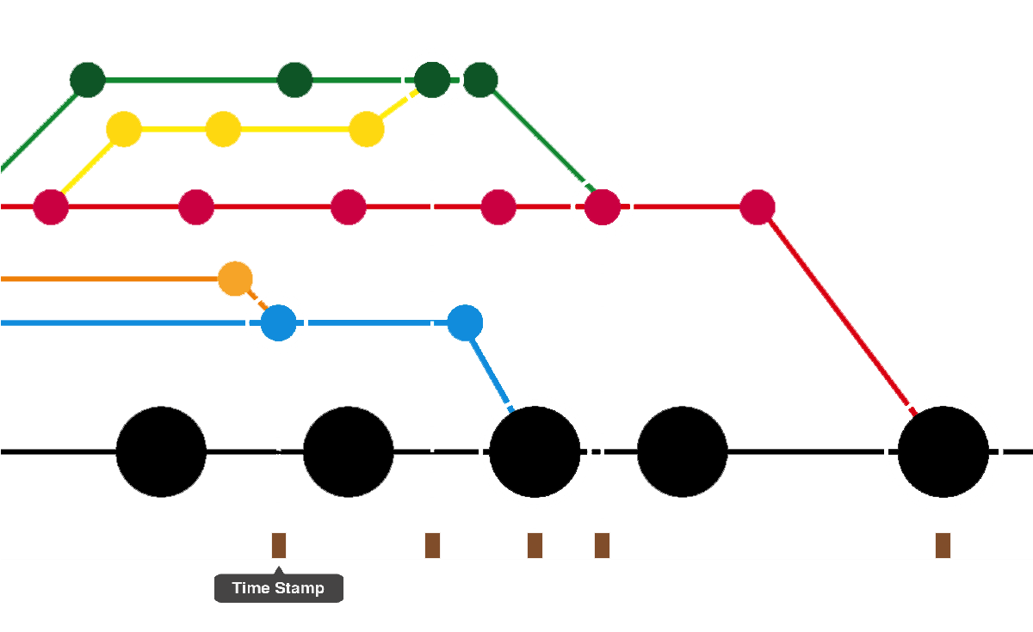

Exchanging and Merging
Idea Generation and Goal Definition
Planning and Management
Distributed Content Management
Product Development
Digital Publishing

Slide 11
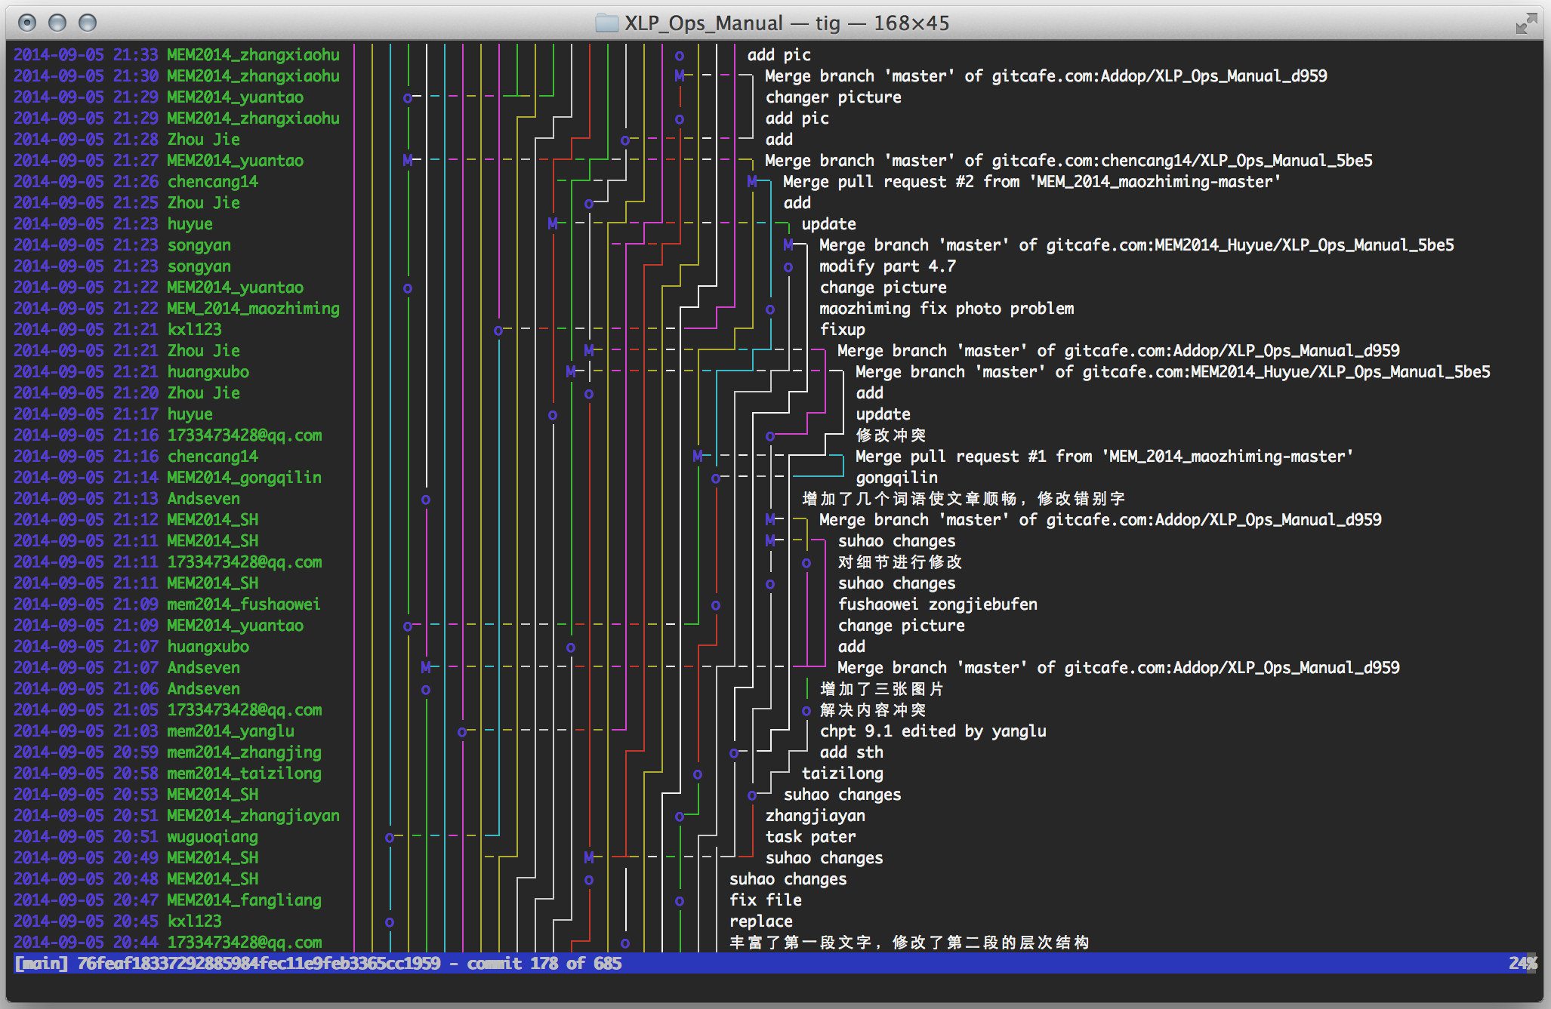
Process Data using Git

Slide 12


Student Created Tools

Slide 13
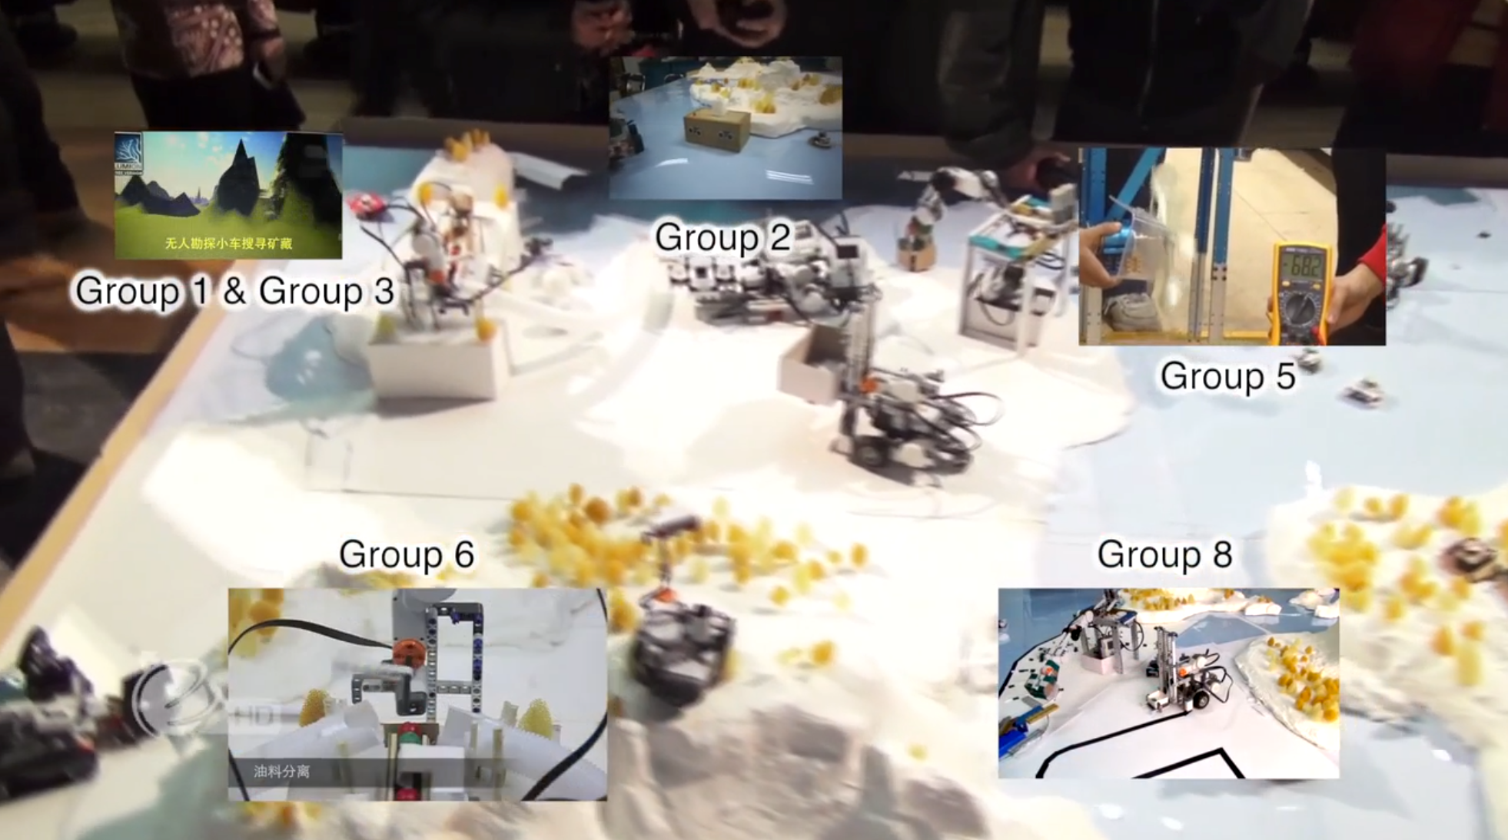
Developing Digital Nations (Jan. 2013)
(Video: http://youtu.be/drm5SCDEyQs)

Slide 14
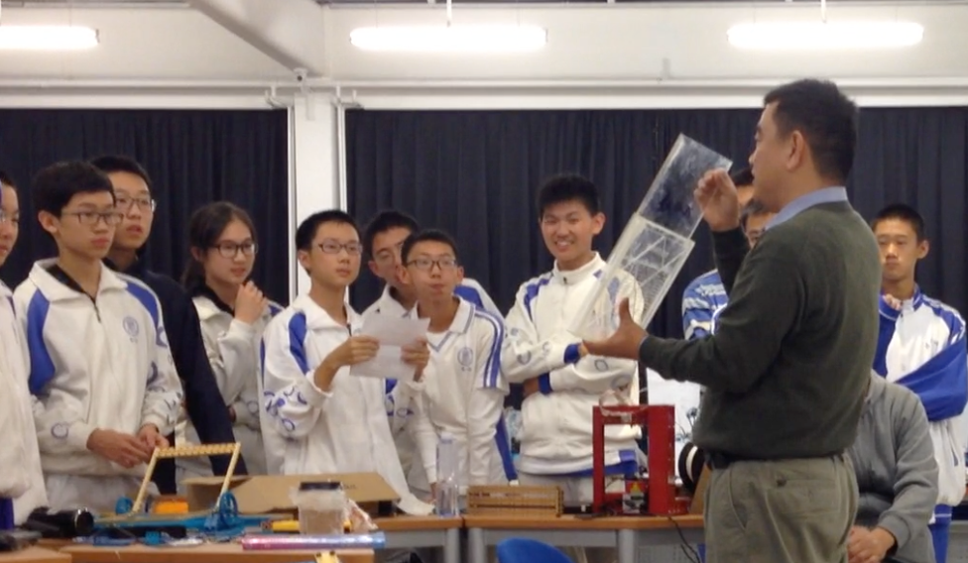
Digital Publishing Workflow
Constitutions of XLP-based Learning Spaces

Slide 15
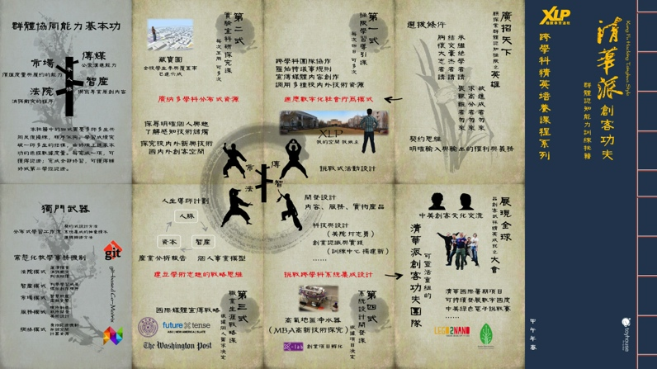
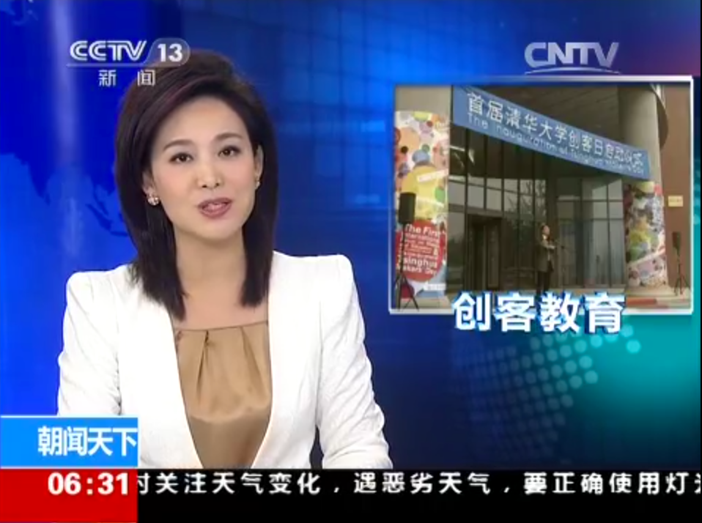
XLP Course Series as an Associate Degree Program

Slide 16
Deliverables on Jan. 29th
Digital Identities + Constitution
WebSite with Linked Ref.
Three Minute Video
Physical Artifacts
Process Data
Ceremony
Notes:
XLP expands the social and physical boundaries of crowd learning using digital publishing workflow.

Slide 17

Content to be Featured on (Deadline: Jan 28th, 2014, EST)
Notes:
XLP expands the social and physical boundaries of crowd learning using digital publishing workflow.

Slide 18
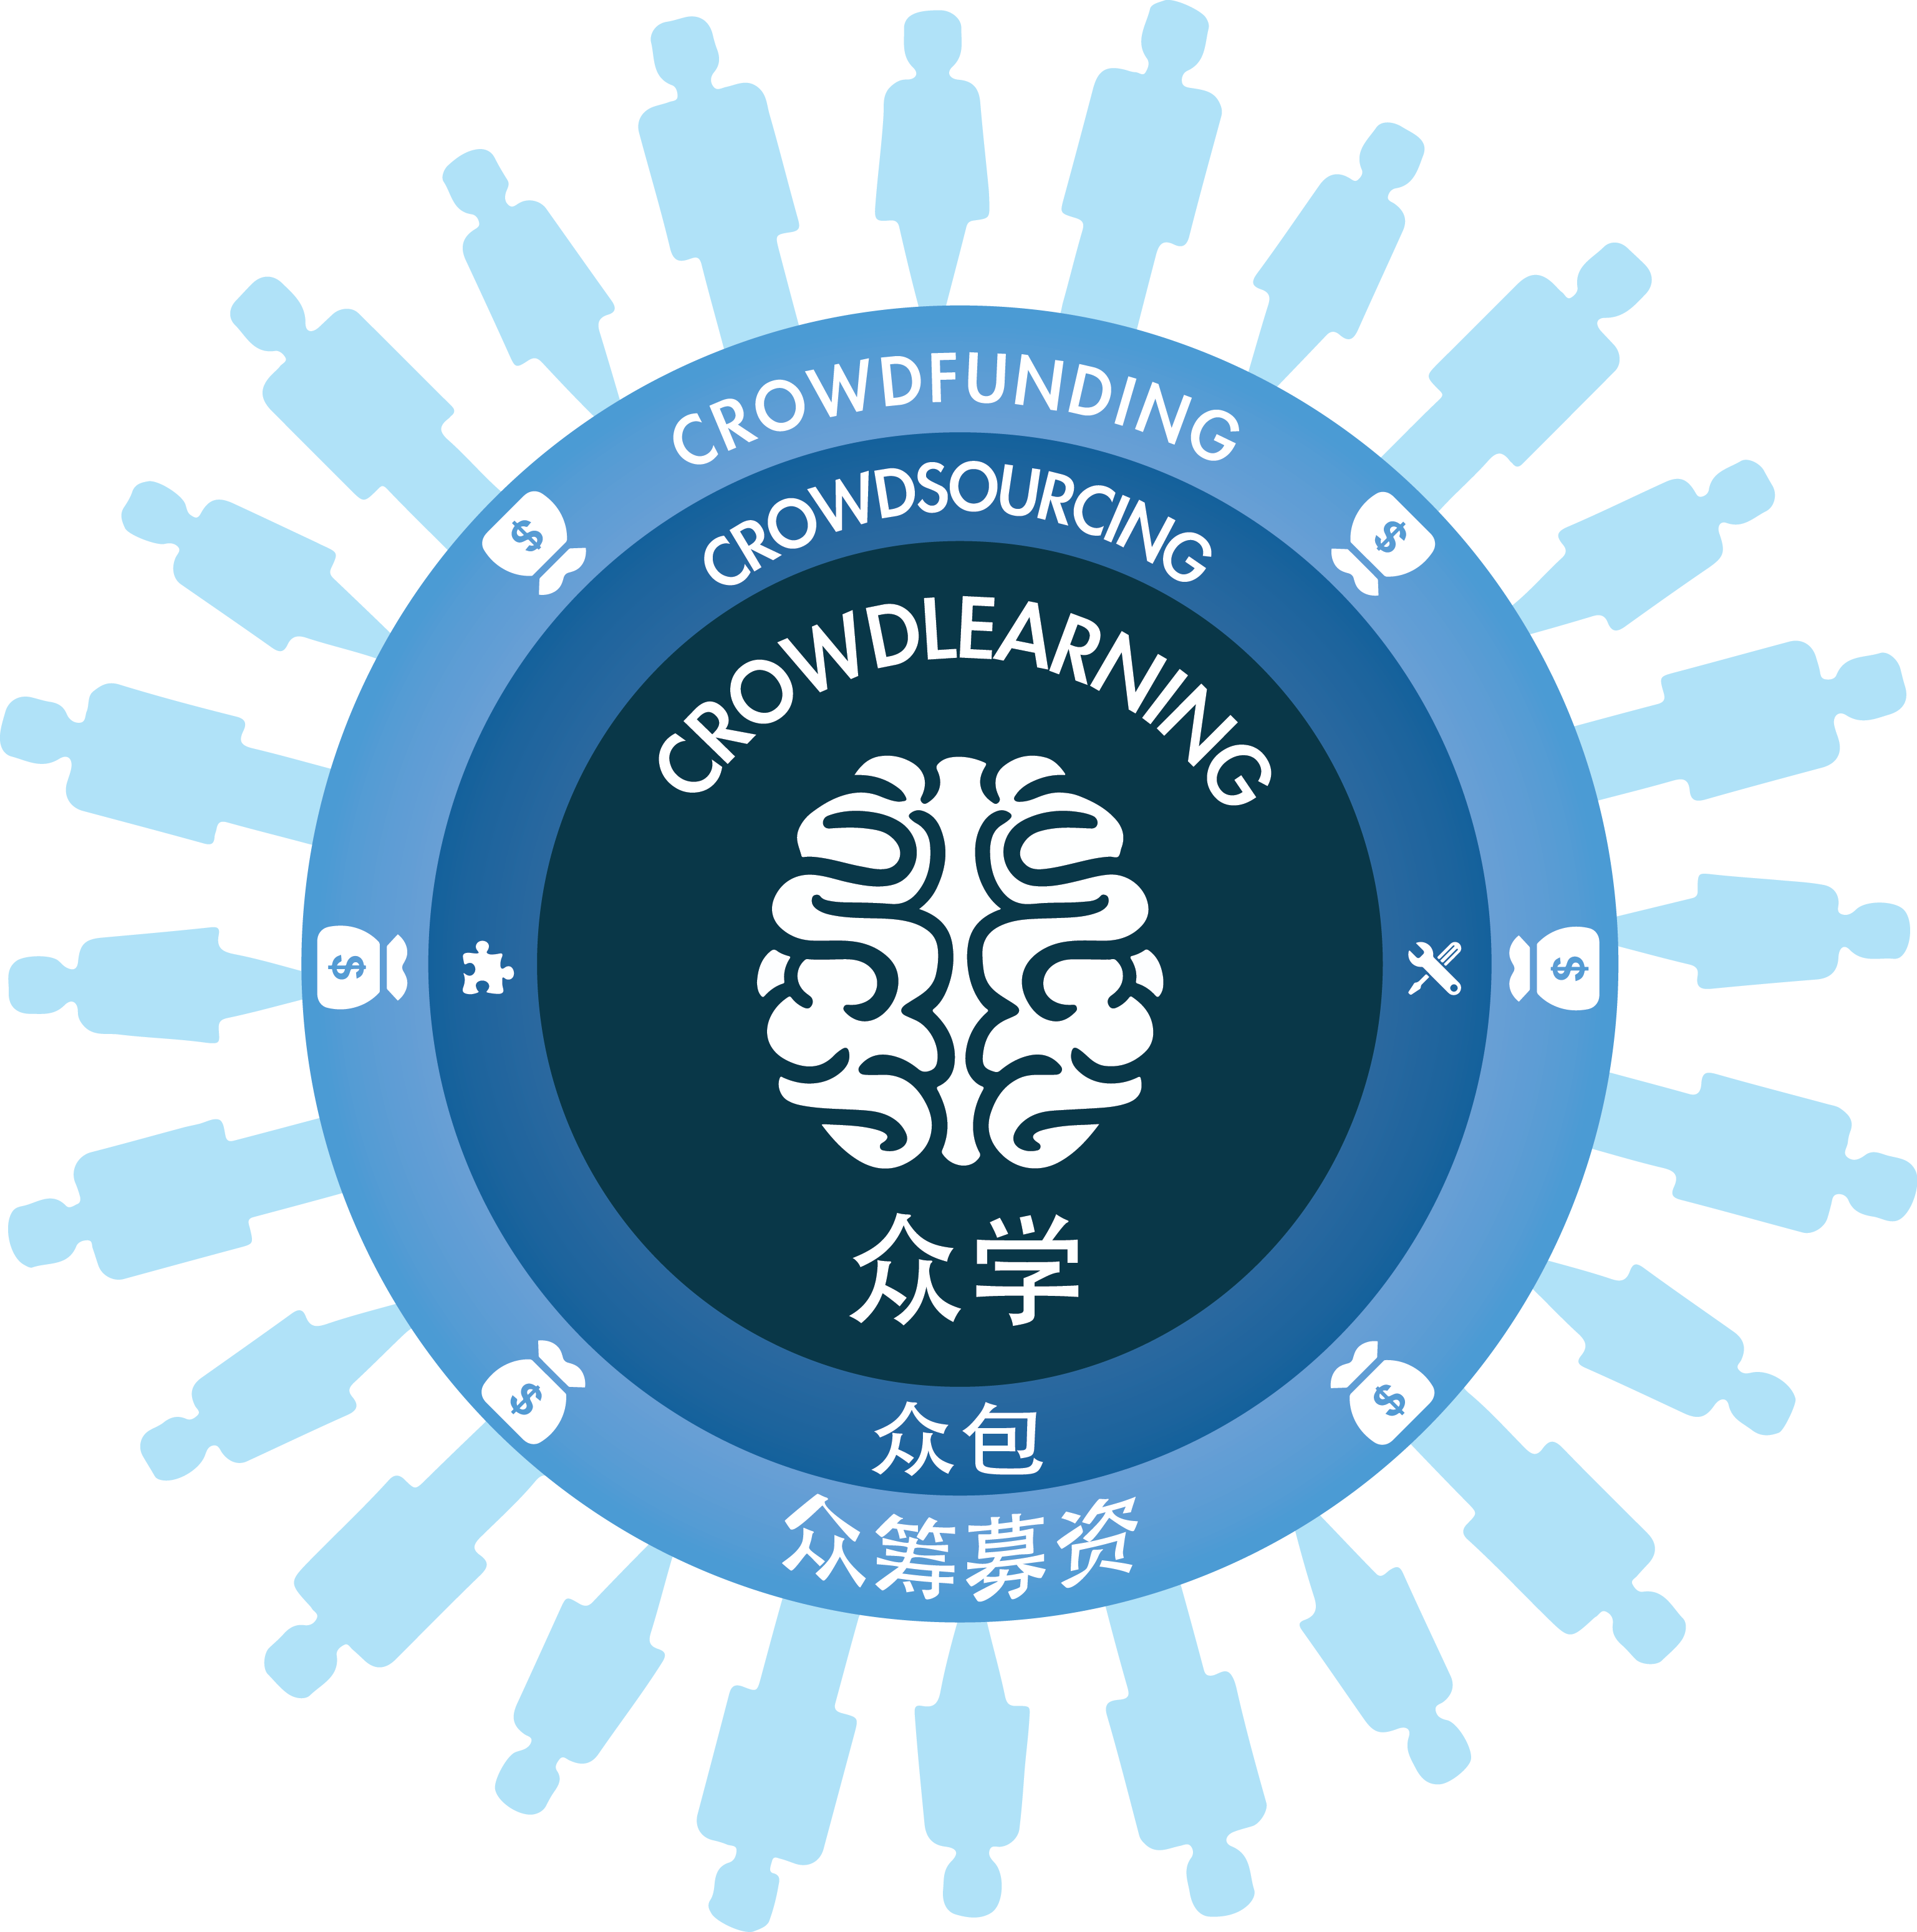
Notes:
XLP expands the social and physical boundaries of crowd learning using digital publishing workflow.

Slide 19

a SCALABLE Learning Activity
Design Methodology
INTERNET SCALE

